Slide 1
Beyond the pie: Communicating with objects using menu based natural Language interfaces
By:
Tanmaya Kumar

Slide 2
Need for PIE 2.0
The Habitability Issue: Researchers have tried time and again for the past 40 years to overcome the Habitability issue and communicate with computer systems.
Undershooting: When a user provides a system with a task too trivial for it’s purpose and thus, is able to utilize only a fraction of the systems ability.
Overshooting: When a user provides a command too difficult for the system to interpret and implement.
Ontology and Identity: Objects around us are unaware of what they are and what super class of objects they may belong to.
Usability: A passing avatar cannot learn a new command language every time they meet a new object, but they can be guided through the command building process using a sequence of menus!

Slide 3
What we did:
Created a group of menu’s, each pertaining to a separate task for commanding the robots on the University Island.
Put the menus together using a GUI similar in shape and feel to the pie built inside Second Life.
Test Subjects: The new pie was designed as a prototype, particularly focusing on the command language for the small robots on the University of Arkansas Island.

Slide 4
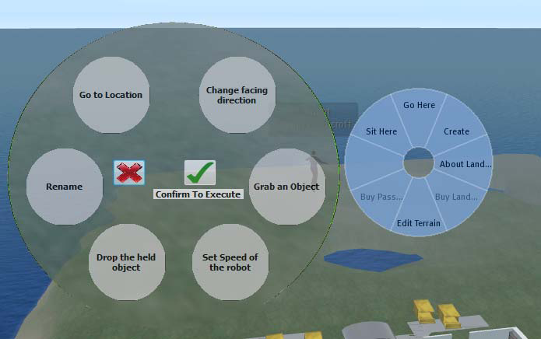
Old vs. the New
Fig. 01: The new pie interface (left) vs. the one provided by Second Life (right)

Slide 5
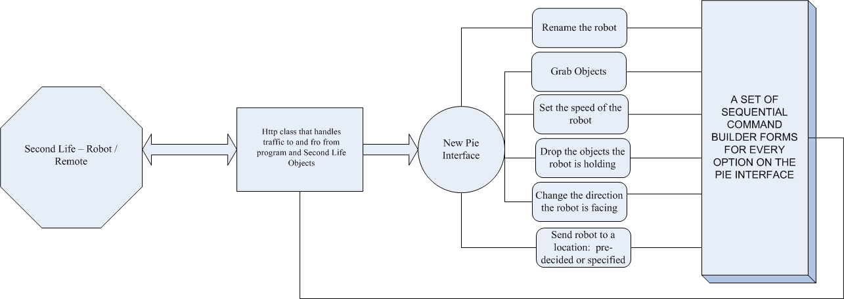
Flow Sequence for the New Pie and the Associated Robot command language
Fig. 02: The program design and interaction paradigm

Slide 6
What’s on our Radar
The extension of the project to cover a wider variety of API’s and not just work for the Robots.
Inclusion of the concept of Ontology is a crucial aim of the project. A clear understanding of Super and Sub Classes:
“Lights” Turn ON – should turn on all Lights without any distinction.
Lights on the Table Turn ON – should turn on only the lights that know they are “Lights” and are on the “Table”.
Creating a Grammar cloud that the user can access on the fly and which downloads and gets displayed on to the PIE on the fly, thus supporting any number of object Grammars and Command languages.

Slide 7
What Linden Labs Did
The viewer 2.0 Which was released from Beta recently does not have a pie anymore.
It supports a drop down menu box instead. Which has all the same options as before, only the GUI has changed form.
We might shift to that way of displaying our PIE and might move to Command Builder Sequential Menu form of issuing commands to objects.

Slide 8
Potential Impact:
The biggest eye popper: We believe it is possible that all inanimate objects will have wrappers and their own customizes grammars in the near future.
These Grammars will be uniform and will be able to command all hierarchies of the objects. One grammar for one thermostats will be able to accommodate functionality for thermostats from all manufacturers.
These will allow us Humans to download them on the fly and then Talk to Objects around us or even far away form us.
The Smart Phone will be so much more. It will possess an RFID Reader and a Grammar building app. Allowing us to locate, and talk to the desired objects!

Slide 9
Thank you for a very patient hearing!

